Slide 1
Case study Ie 4362
Brennan Lacour

Slide 2
Background information
Many students do not pay much attention to their posture while they study, which can lead to pain and even musculoskeletal disorders if enough time is spent in these positions. Using the data taken from a previous study by IE students, we are trying to determine whether studying on a coach, a hallway floor, or at a desk is significantly different, and if so, which is best for their posture to reduce the probability that students will develop musculoskeletal disorders.

Slide 3
About the data
- The data set was collected in 2011 by a group of 3 students preparing a project for their class.
- They measured three variables related to posture: the angle of the neck, angle of the wrist, and the distance from the eyes to the screen.
- These three variables were measured across ten participants, each sitting on a couch, on the floor, and at a desk.

Slide 4
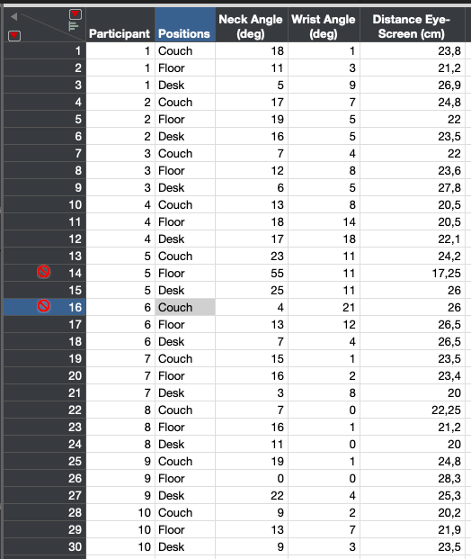
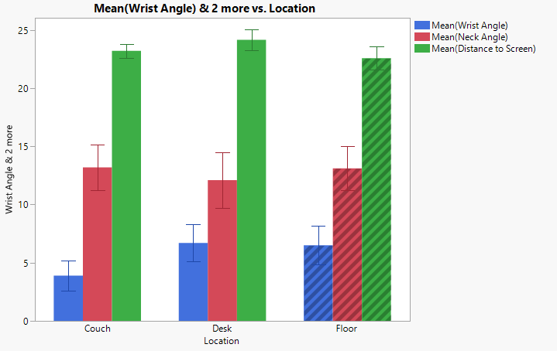
Data and tables

Slide 5
Original Data
● The data provided by the study gives us an idea of how the distance from the eyes to the screen, and the angles of the neck and wrists varies according to the posture obtained.
● This table created provides some descriptive statistics information about the means, maximums, minimums and standard deviation of each of the positions and related variants.

Slide 6
Trimmed Data
● While Analyzing the data provided, looking at graphs and data calculated in the table from the previous slide, we have decided to dispense with some possible outliers.

